Slide 1




Current State of U.S. Trade Policy
Tariffs, Trade Policy, and What Comes Next
Ron Sorini and Rick Helfenbein
Sorini Strategic Advisors
March 2 / 3, 2026
Sorini Strategic Advisors • 1310 L Street Northwest, Suite 300, Washington, D.C. • www.ssa-dc.com

Slide 2
Executive Action Comparison & Trump 2.0 Goals
Executive Action Comparison*
Jimmy Carter (D) | Ronald Reagan (R) | George Bush (R) | William J. Clinton (D) | George W. Bush (R) | Barack Obama (D) | Donald J. Trump (R) - I | Joesph R. Biden (D) | Donald J. Trump (R) - II
4 Years | 4 Years | 4 Years | 8 Years | 8 Years | 8 Years | 4 Years | 4 Years | Years 1 & 2 of 4
320 | 381 | 166 | 364 | 291 | 276 | 220 | 162 | 243
Tariffs, Trade Policy, and What Comes Next
*Does not include Presidential Proclamations & Memorandums
Seeks to “forge a balanced international economic order” using “pro-growth policies delivering for American workers.”
  Reindustrialize the United States.
  Reduce the U.S. global trade deficit + the U.S. budget deficit.
  Reshape global supply chains, particularly those dependent on China.
  Reinforce “America First” foreign policy goals.
Sorini Strategic Advisors • 1310 L Street Northwest, Suite 300, Washington, D.C. • www.ssa-dc.com
Notes:
https://www.presidency.ucsb.edu/statistics/data/executive-orders

Slide 3

Partner | Announced | Type / Description | Status (as of Feb 2026)
United Kingdom (UK) | May 8, 2025 | “Economic Prosperity Deal” / framework with tariff terms and quotas | Framework agreed; partial implementation of tariff terms via administrative action; ongoing negotiation to fully finalize details.
Vietnam | Jul 2, 2025 | Framework Agreement | Framework implemented through executive tariff modifications; final negotiations continue; further detail/deeper legal implementing documents pending.
Japan | Jul 22, 2025 | Framework Agreement | Tariff terms in effect as part of later Executive Orders; investment commitments ongoing.
European Union | Aug 21, 2025 | Framework Agreement | Certain tariff terms in effect; EU still debating how to enact commitments.
Malaysia | Oct 26, 2025 | Agreement on Reciprocal Trade | Tariff rates and exemptions under Executive Orders; further formal documents pending.
Cambodia | Oct 26, 2025 | Agreement on Reciprocal Trade | Tariff rates and exemptions under Executive Orders; further formal documents pending.
Thailand | Oct 26, 2025 | Framework Agreement | Framework agreed; tariff schedules and implementation details pending.
Ecuador | Nov 13, 2025 | Framework Agreement | Framework agreed; tariff reductions on select products reported; full formal implementation pending; final text to be signed soon.
Switzerland & Liechtenstein | Nov 14, 2025 | Framework Agreement | Framework announced and tariff reductions implemented; agreement expected to be finalized by end of Q1 2026.
Trump Trade “Deals”
Tariffs, Trade Policy, and What Comes Next
Sorini Strategic Advisors • 1310 L Street Northwest, Suite 300, Washington, D.C. • www.ssa-dc.com

Slide 4
Partner | Announced | Type / Description | Status (as of Feb 2026)
South Korea | Nov 13, 2025 | Korea Strategic Trade & Investment Deal | Framework agreed; implementation guidance issued and certain tariff reductions implemented, but full legal/EO action pending.
El Salvador | Jan 29, 2026 | Agreement on Reciprocal Trade | Deal signed; certain CAFTA-DR qualifying goods exempted from tariffs. Implementation pending.
Guatemala | Jan 30, 2026 | Agreement on Reciprocal Trade | Deal signed; certain CAFTA-DR qualifying goods exempted from tariffs. Implementation pending.
Argentina | Feb 5, 2026 | Agreement on Reciprocal Trade and Investment | Deal signed; tariff reductions on some products reported (e.g., beef) but full implementation pending.
India | Feb 6, 2026 | Interim Agreement | Terms not yet implemented; countries working toward final bilateral agreement.
Bangladesh | Feb 9, 2026 | Agreement on Reciprocal Trade | Deal signed; includes possible tariff elimination for certain textiles and apparel. Implementation pending.
Taiwan | Feb 12, 2026 | Agreement on Reciprocal Trade | Deal signed; implementation pending. Complements previous memorandum of understanding issued by the Department of Commerce.
Indonesia | Feb 19, 2026 | Agreement on Reciprocal Trade | Deal signed; includes possible tariff elimination for certain textiles and apparel. Implementation pending.
Trump Trade “Deals”
Tariffs, Trade Policy, and What Comes Next
Sorini Strategic Advisors • 1310 L Street Northwest, Suite 300, Washington, D.C. • www.ssa-dc.com

Slide 5

Supreme Court Nullification of IEEPA Tariffs
On February 20, 2026, the Supreme Court ruled
6 – 3 that the International Emergency Economic Powers Act (“IEEPA”) “does not authorize the President to impose tariffs.”
President Trump immediately denounced the decision, levied replacement, temporary tariffs, and pledged the imposition of longer lasting tariffs under other legal authorities.
Tariffs, Trade Policy, and What Comes Next
Sorini Strategic Advisors • 1310 L Street Northwest, Suite 300, Washington, D.C. • www.ssa-dc.com

Slide 6
Supreme Court Nullification of IEEPA Tariffs
Invalidated
IEEPA China Fentanyl Tariffs (10%)
IEEPA Canada Fentanyl Tariffs (35%)
IEEPA Mexico Fentanyl Tariffs (25%)
IEEPA Reciprocal Tariffs (10%-41%)
IEEPA Brazil Tariffs (40%)
IEEPA India Tariffs (25% - terminated February 7)
IEEPA Tariff Threats (Russian oil importers; Venezuelan oil importers; Iranian trade partners; and suppliers of oil to Cuba)
Tariffs, Trade Policy, and What Comes Next
Sorini Strategic Advisors • 1310 L Street Northwest, Suite 300, Washington, D.C. • www.ssa-dc.com

Slide 7
Supreme Court Nullification of IEEPA Tariffs
Not Affected
Most-favored-nation (“MFN”) tariffs
Existing and Future Antidumping/Countervailing Duties
Existing and Future Section 201 Tariffs
Existing and Future Section 232 Tariffs
Existing and Future Section 301 Tariffs
Existing and Future Section 122 Tariffs
Future Section 338 Tariffs (if imposed)
Tariffs, Trade Policy, and What Comes Next
Sorini Strategic Advisors • 1310 L Street Northwest, Suite 300, Washington, D.C. • www.ssa-dc.com

Slide 8
IEEPA Tariff Replacements
Statute | Issue | Powers | Requirements before Action
Section 122 | Balance-of-payments deficits | Tariffs up to 15% or quotas, lasting up to 150 days* | None
Section 201 | Safeguarding U.S. industry from injury | Tariffs up to 50%, quotas, or other action | Investigation
Section 232 | Threats to U.S. national security | Tariffs, quotas, or other action | Investigation
Section 301 | Unfair foreign trade practices | Tariffs, quotas, or other action | Investigation
Section 338 | Direct or indirect discrimination against U.S. commerce | Tariffs up to 50%, lasting indefinitely | None
Tariffs, Trade Policy, and What Comes Next
President Trump has already ordered a global 10% Section 122 tariff for 150 days – effective February 24.
  Stacks on top of MFN duties; President promised an increase to 15%, but not yet formally implemented.
Additional investigations and actions under Section 232 and Section 301 are extremely likely.
  Section 232 and Section 301 tariffs may be used to “rebuild” the terms of bilateral reciprocal trade deals.
Congress could take action to formalize the President’s IEEPA tariffs, but chances are low.
Sorini Strategic Advisors • 1310 L Street Northwest, Suite 300, Washington, D.C. • www.ssa-dc.com

Slide 9
IEEPA vs. Section 122 Tariff Rates
Sorini Strategic Advisors • 1310 L Street Northwest, Suite 300, Washington, D.C. • www.ssa-dc.com

Slide 10
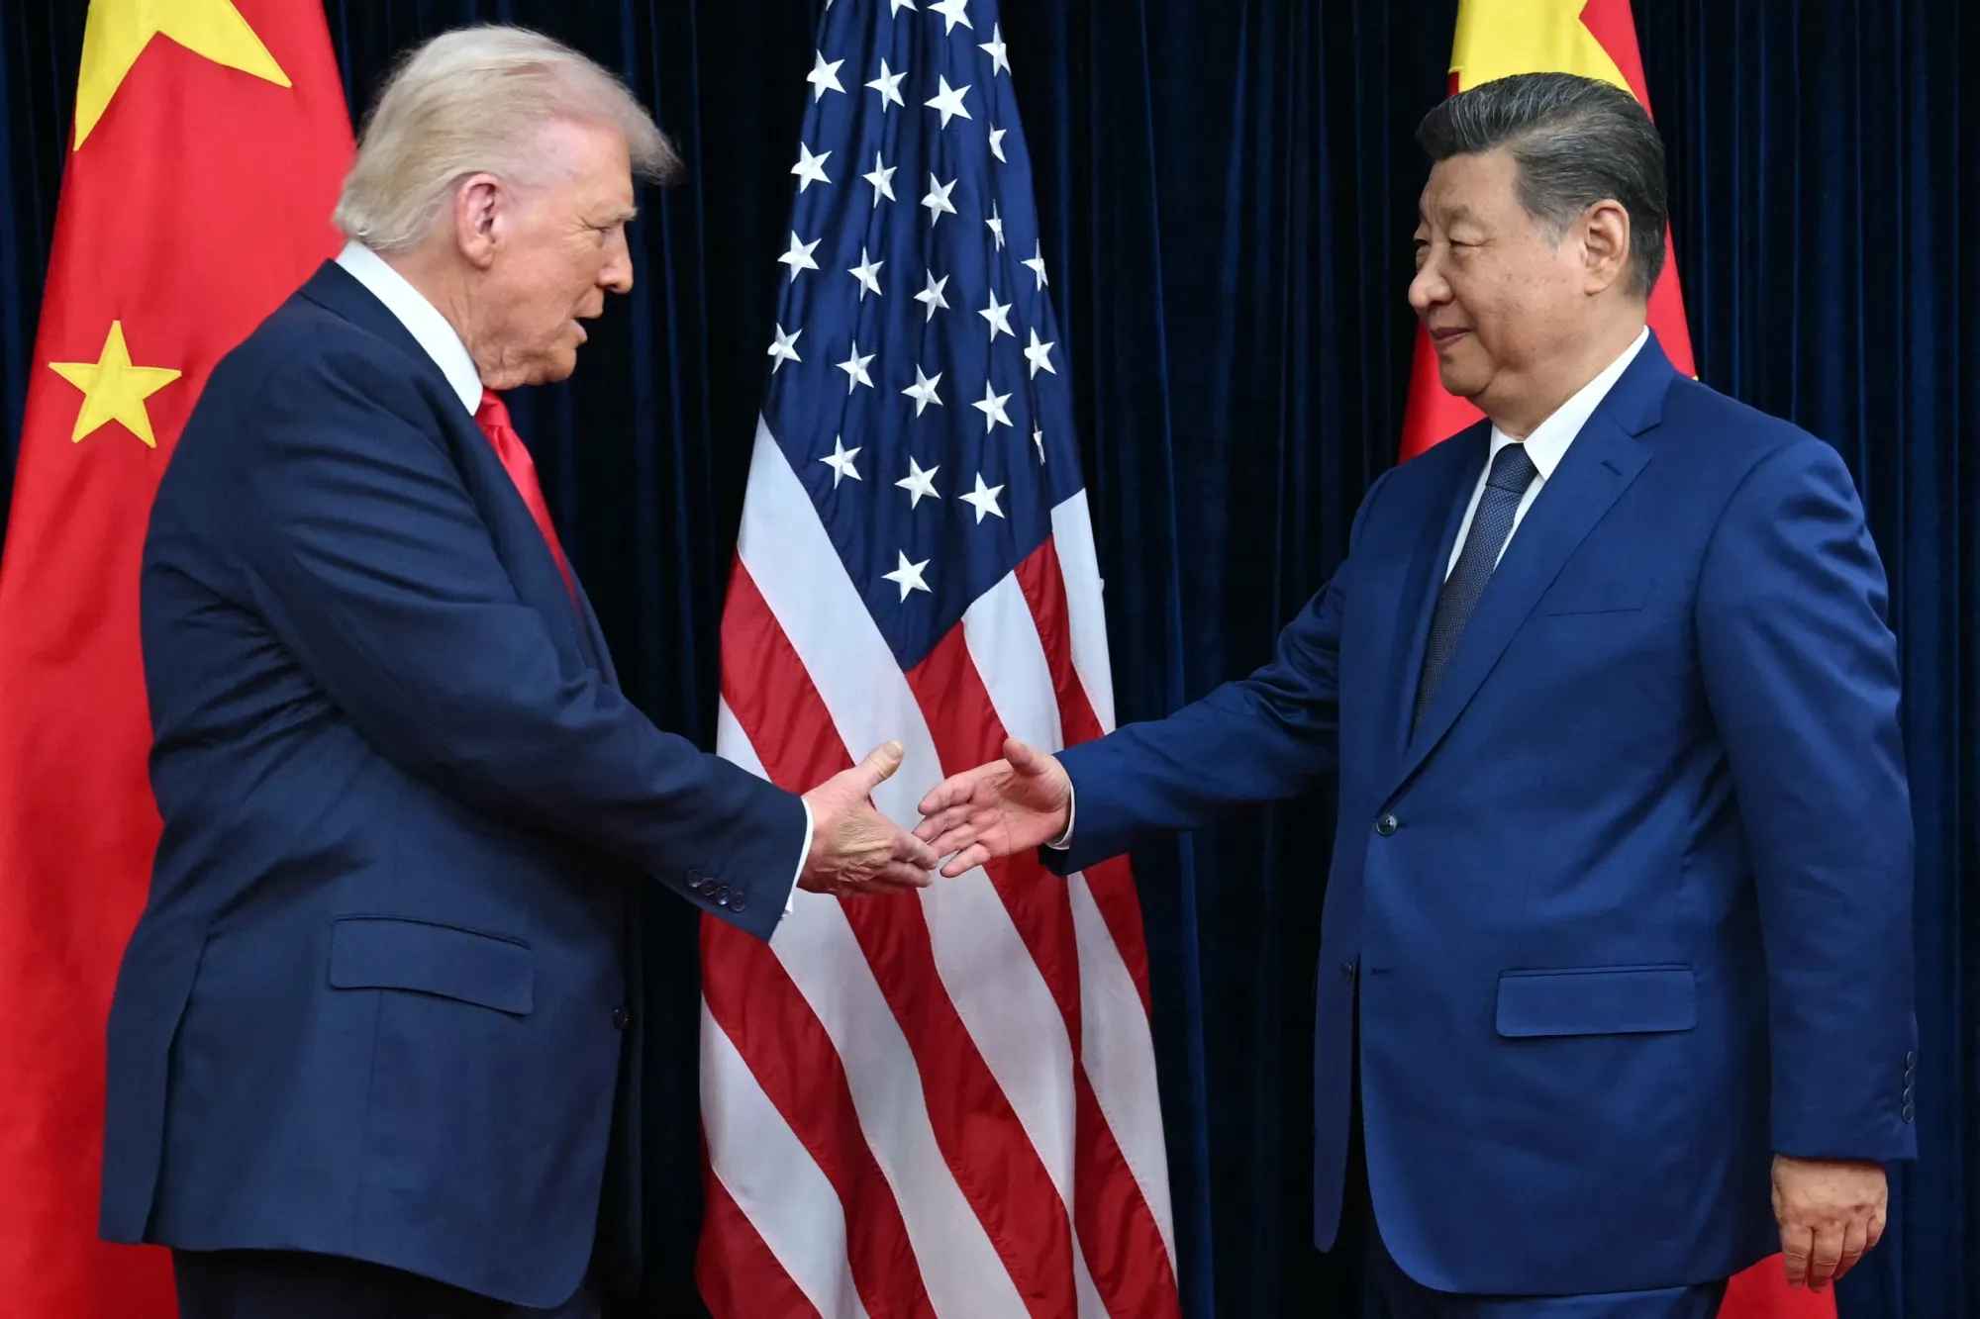
U.S.-China Relations
In October 2025, the Trump-Xi summit resulted in:
  IEEPA Fentanyl tariff: 20% → 10%.
  IEEPA Reciprocal tariff: Continuation of 10%.
  Section 301 China tariff product exclusions: Extended until November 10, 2026.
President Trump is traveling to China in April 2026 to meet again with President Xi.
The 4-Year Review of Section 301 China action will be initiated in April or May 2026; tariff modifications possible in late 2026 – early 2027.
Several other Section 301 investigations involving China remain active and could lead to tariffs.
Tariffs, Trade Policy, and What Comes Next
Sorini Strategic Advisors • 1310 L Street Northwest, Suite 300, Washington, D.C. • www.ssa-dc.com

Slide 11
Questions?
Ron Sorini
Principal
Sorini Strategic Advisors
rsorini@ssa-dc.com
Rick Helfenbein
Special Advisor
Sorini Strategic Advisors
rhelfenbein@ssa-dc.com
Tariffs, Trade Policy, and What Comes Next
Sorini Strategic Advisors • 1310 L Street Northwest, Suite 300, Washington, D.C. • www.ssa-dc.com

